Slide 1
Spring framework
by
Venkata Anil Kumar

Slide 2
Spring Advice Types
• Before method
– Non-critical advisor bean type
– Called before method execution
• After returning method
– Non-critical advisor bean type
– Called after normal method execution
• After throwing exception
– Non-critical advisor bean type
– Called after method execution exits with an exception
• Around advice
– Critical advisor bean type
– Wraps method execution

Slide 3
Spring AOP Example – PointCut and Advisors
In last Spring AOP advice examples, all the methods in a class will be intercept automatically. But for most cases, you may need a way to intercept only one or two methods, this is what ‘Pointcut’ is.
Pointcut allow’s you to intercept a method by it’s method name. In addition, a ‘Pointcut’ must be associated with an ‘Advisor’.
In Spring AOP, comes with three very technical terms - Advices, Pointcut , Advisor, put it in unofficial way…
Advice – Indicate the action to take either before or after the method execution.
Pointcut – Indicate which method should be intercept, by method name or regular expression name.
Advisor – Group ‘Advice’ and ‘Pointcut’ into a single unit, and pass it to a proxy factory object.
Project: SpringAOP (package is com.samples.aop.customerservice.pointcut and Spring-Customer-Pointcut.xml)

Slide 4
Spring AOP + AspectJ Annotation
1. Common AspectJ annotations :
@Before â€“ Run before the method execution
@After â€“ Run after the method returned a result
@AfterReturning – Run after the method returned a result, intercept the returned result as well.
@AfterThrowing â€“ Run after the method throws an exception
@Around â€“ Run around the method execution, combine all three advices above.
2. To enable AspectJ, you need aspectjrt.jar, aspectjweaver.jar and spring-aop.jar
3. Enable AspectJ
In Spring configuration file, put “<aop:aspectj-autoproxy />“, and define your Aspect (interceptor) and normal bean.

Slide 5
Spring AOP Example – Annotation based Advices
@Aspect
public class LoggingAspect {
@Before("execution(* com.anil.customer.bo.CustomerBo.addCustomer(..))")
public void logBefore(JoinPoint joinPoint) {
}
@After("execution(* com.anil.customer.bo.CustomerBo.addCustomer(..))")
public void logAfter(JoinPoint joinPoint) {
}
@AfterReturning(pointcut = "execution(* com.anil.customer.bo.CustomerBo.addCustomerReturnValue(..))",
@AfterThrowing( pointcut = "execution(* com.anil.customer.bo.CustomerBo.addCustomerThrowException(..))", throwing= "error")
public void logAfterThrowing(JoinPoint joinPoint, Throwable error) {
}
Notes:
AspectJ @AfterReturning
In below example, the logAfterReturning() method will be executed after the execution of customerBo interface,addCustomerReturnValue() method. In addition, you can intercept the returned value with the “returning” attribute.
To intercept returned value, the value of the “returning” attribute (result) need to be same with the method parameter (result).
7. AspectJ @AfterReturning
In below example, the logAfterThrowing() method will be executed if the customerBo interface,addCustomerThrowException() method is throwing an exception.
8. AspectJ @Around
In below example, the logAround() method will be executed before the customerBo interface, addCustomerAround()method, and you have to define the “joinPoint.proceed();” to control when should the interceptor return the control to the original addCustomerAround() method.

Slide 6
Spring AOP Example – Annotation based Advices
@Around("execution(* com.anil.customer.bo.CustomerBo.addCustomerAround(..))")
public void logAround(ProceedingJoinPoint joinPoint) throws Throwable {
System.out.println("logAround() is running!");
System.out.println("hijacked method : " + joinPoint.getSignature().getName());
System.out.println("hijacked arguments : " + Arrays.toString(joinPoint.getArgs()));
System.out.println("Around before is running!");
joinPoint.proceed(); //continue on the intercepted method
System.out.println("Around after is running!");
System.out.println("******");
}
}
Notes:
AspectJ @AfterReturning
In below example, the logAfterReturning() method will be executed after the execution of customerBo interface,addCustomerReturnValue() method. In addition, you can intercept the returned value with the “returning” attribute.
To intercept returned value, the value of the “returning” attribute (result) need to be same with the method parameter (result).
7. AspectJ @AfterReturning
In below example, the logAfterThrowing() method will be executed if the customerBo interface,addCustomerThrowException() method is throwing an exception.
8. AspectJ @Around
In below example, the logAround() method will be executed before the customerBo interface, addCustomerAround()method, and you have to define the “joinPoint.proceed();” to control when should the interceptor return the control to the original addCustomerAround() method.

Slide 7
Spring Database Components
(DAO Support)

Slide 8
Consistent Abstract Classes for DAO Support
Extend your DAO classes with the proper xxxDAOSupport class that matches your persistence mechanism.
JdbcDaoSupport
  Super class for JDBC data access objects.
  Requires a DataSource to be set, providing a JdbcTemplate based on it to subclasses.
HibernateDaoSupport
  Super class for Hibernate data access objects.
  Requires a SessionFactory to be set, providing a HibernateTemplate based on it to subclasses.
JdoDaoSupport
  Super class for JDO data access objects.
  Requires a PersistenceManagerFactory to be set, providing a JdoTemplate based on it to subclasses.
SqlMapDaoSupport
  Supper class for iBATIS SqlMap data access object.
  Requires a DataSource to be set, providing a SqlMapTemplate

Slide 9
Object Relational Mapping (ORM) data access

Slide 10
Object Relational Mapping (ORM) data access
Hibernate is a ORM mapping tool. The following section describes the Spring with Hibernate.
Creating Data source
<bean id="myDataSource" class="org.springframework.jdbc.datasource.DriverManagerDataSource" destroy-method="close">
<property name="driverClassName" value="com.mysql.jdbc.Driver"/>
<property name="url" value="jdbc:mysql://localhost:3306/springdb"/>
<property name="username" value="root"/>
<property name="password" value="sql123"/>
</bean>
Or using JNDI DataSource
<bean id="myJndiDataSource" class="org.springframework.jndi.JndiObjectFactoryBean">
<property name="jndiName" value="java:/DefaultDS"/>
</bean>

Slide 11
Object Relational Mapping (ORM) data access
2. Configure Hibernate SessionFactory in Spring Application
<bean id="mySessionFactory" class="org.springframework.orm.hibernate3.LocalSessionFactoryBean">
<property name="dataSource" ref="myDataSource"/>
<property name="useTransactionAwareDataSource" value="true" />
<property name="mappingResources">
<list>
<value>org/spring/beans/HbEmployee.hbm.xml</value>
<value>sdfsd/fdsfdsf/sdfabc.hbm.xml</value>
</list>
</property>
<property name="hibernateProperties">
<props>
<prop key="hbm2ddl.auto">create</prop>
<prop key="hibernate.jdbc.batch_size">5</prop>
</props>
</property>
</bean>

Slide 12
Object Relational Mapping (ORM) data access
3. Using Hibernate Template to perform CRUD operations
public class ProductDaoImpl implements ProductDao {
private HibernateTemplate hibernateTemplate;
public void setSessionFactory(SessionFactory sessionFactory) {
this.hibernateTemplate = new HibernateTemplate(sessionFactory);
}
public Collection loadProductsByCategory(String category) throws DataAccessException {
return this.hibernateTemplate.find("from Product product where product.category=? ", category);
}
}

Slide 13
Object Relational Mapping (ORM) data access
Using HibernateDAOSupport to reduce the Code complexity
public class ProductDaoImpl extends HibernateDAOSupport implements ProductDao {
public Collection loadProductsByCategory(String category) throws DataAccessException {
return this.getHibernateTemplate().find("from Product product where product.category=? ", category);
}
}

Slide 14
Object Relational Mapping (ORM) data access
Example 1: Using HibernateCallbacks
public List<Product> loadProductsByCategory(final String category) throws DataAccessException {
return (List<Product>) this.hibernateTemplate.execute(
new HibernateCallback() {
public Object doInHibernate(Session session) throws HibernateException, SQLException {
Criteria criteria = session.createCriteria(Product.class);
criteria.add(Expression.eq("category", category));
criteria.setMaxResults(6);
return criteria.list();
}
});
}

Slide 15
Object Relational Mapping (ORM) data access
Example 2: Implementing DAOs based on plain Hibernate 3 API
Hibernate 3 provides a feature called "contextual Sessions", where Hibernate itself manages one current Session per transaction. This is roughly equivalent to Spring's synchronization of one Hibernate Session per transaction. A corresponding DAO implementation looks like as follows, based on the plain Hibernate API.
public class ProductDAOImpl2 implements ProductDAO {
private SessionFactory sessionFactory;
public void setSessionFactory(SessionFactory sessionFactory) {
this.sessionFactory = sessionFactory;
}
public List<Product> loadProductsByCategory(String category) {
return this.sessionFactory.getCurrentSession()
.createQuery("from Product product where product.category = ?")
.setParameter(0, category)
.list();
}
}

Slide 16
Ex: Code without a template
public class OrderHibernateDAO implements IOrderDAO {
public Order saveOrder(Order order) throws OrderException{
Session s = null;
Transaction tx = null;
try{
s = ... // get a new Session object
tx = s.beginTransaction();
s.save(order);
tx.commit();
} catch (HibernateException he){
// log, rollback, and convert to OrderException
} catch (SQLException sqle){
// log, rollback, and convert to OrderException
} finally {
s.close(); // needs a try/catch block
}
return order;
}

Slide 17
Ex: Spring DAO Template Example
public class OrderHibernateDAO extends HibernateDaoSupport
implements IOrderDAO {
...
public Order saveOrder(final Order order) {
return (Order) getHibernateTemplate().execute(new HibernateCallback() {
public Object doInHibernate(Session session)
throws HibernateException, SQLException {
session.save(order);
return order;
}
});
}
public List findOrdersByCustomerId(int id) {
return getHibernateTemplate()
.findByNamedQuery(“OrdersByCustomerID”,new Integer(id));
}
public Order findOrderById(int orderId ) {
return (Order) getHibernateTemplate().load(Order. class,
new Integer(orderId));
}
...
}

Slide 18
Spring Web MVC framework
SpringMVC Example

Slide 19
Spring MVC – Key Classes
DispatcherServlet – It dispatches the request to handlers. This will be typically wired into your web.xml and you will map your URL pattern(s) to be handled with Spring MVC.
Dispatcher Servlet is the Front Controller in the Spring MVC application.
ModelAndView – Handler for both Model and View in the web MVC framework. The model is typically handled as a java.util.Map which is returned with the view
Controller – interface to handle the requests
AbstractController -- basic implementation of Controller interface to handle the requests
SimpleFormController - basic implementation of Controller for doing standard web form submissions;
MultiActionController – group related functionality together into a single Controller class.

Slide 20
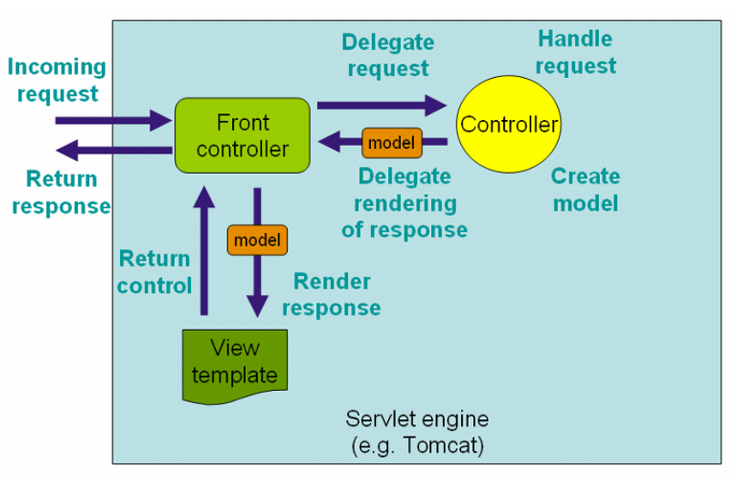
Request Process Flow in Spring Web MVC
•

